Slide 1
Team decision making
James McGill, Coach, The Brainiac Maniacs (Team 25108)

Slide 2
MEET THE AUTHORS
Girl Scout team from Texas
Won the state championship in their rookie season
Attended World Festival Houston in 2018

Slide 3
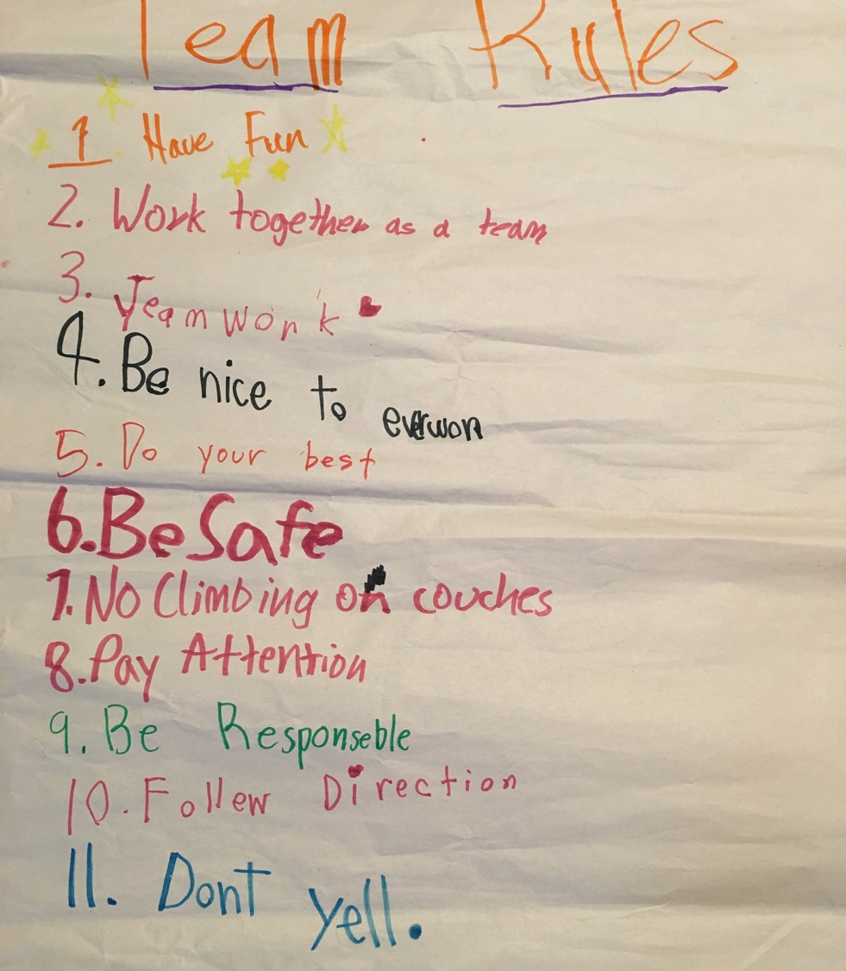
CREATE some Team Rules
Create a set of team “rules” and review and update them at the start of every meeting to set expectations for team behavior
To create the first rules, we review the Lego Core Values, but I always start with “Have fun” and “Kids do the work” and then the kids add from there
Have the kids write their ideas on a big sheet of paper in marker
Suggest some common rules (like talking turns)
For conflicts, I refer to an existing rule or suggest they add a new one

Slide 4
Group Decision-Making
For “big” decisions (team name, project, etc.), create a decision-making process to make it “fair” and consistent, such as
Brainstorm for a set time (3-5minutes) to get as many ideas as possible on post-it notes, white board, etc.
Group similar/same ideas (e.g. team names based on animals, planets, etc.) and do a group vote to select top 3 and revote to select top 1
Vote on specific items in group to select top 3 and revote to select top 1

Slide 5
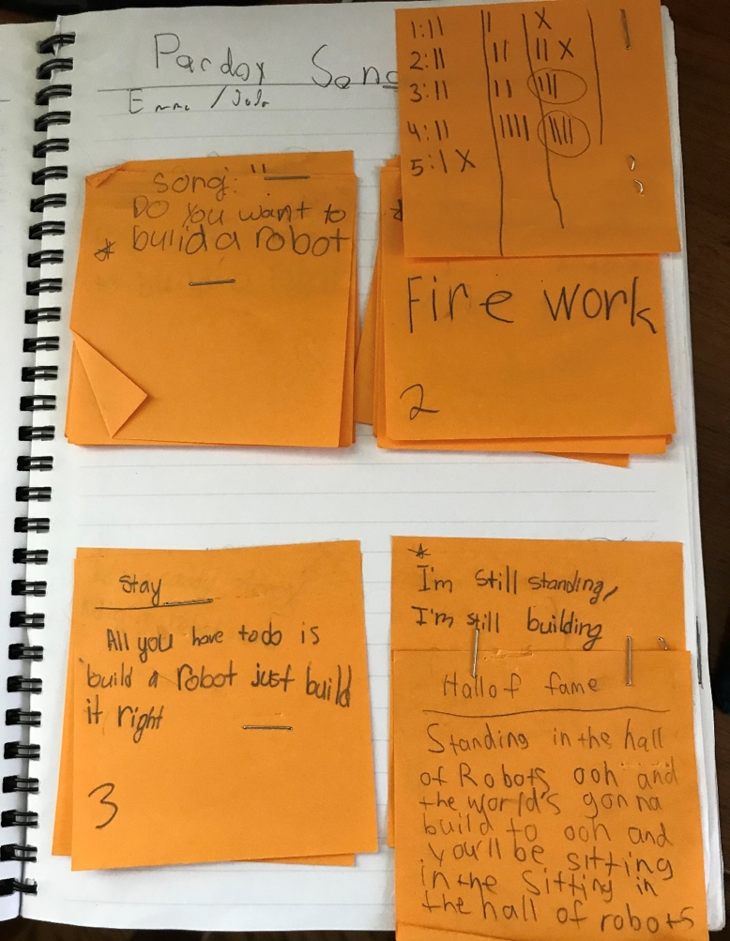
Example of Group Decision-Making
Our team entered the FIRST FIRST Parody song contest
We started with 5 ideas
First round voting narrowed to four
Took two more rounds to get to final selection
Final video: The Brainiac Maniacs made “I’m Still Building” (https://youtu.be/O5BjZQMhvHw)

Slide 6
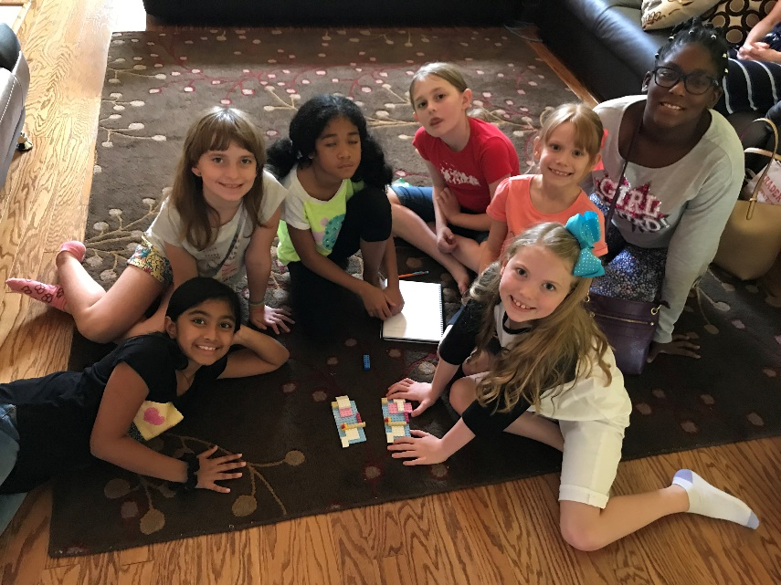
Do activities to improve making decisions
Include one core values practice in every meeting
FLLTutorials.com is an excellent source, but also search for “Destination Imagination Instant Challenges” for many more examples
After each core value exercise ask kids and parents
What went well?
What could have gone better?
How did you communicate?
How can you communicate better?
How well did you plan?
How can you plan better?
Building Duplicate LEGO models

Slide 7
EVERYONE can have a role
Roles can help some teams with core values exercises
It is good to rotate roles so each team members can have experience in each and then let the team decide if they would like set roles, rotating roles or none at all
Roles include
Brainstorm Manager: In charge of fast, focused organized brainstorming of ideas, focused on creativity. May not provide an idea, but can combine ideas from others. Ensures the team starts with a good idea.
Task Manager: In charge of understanding the challenge task, focused on keeping the team on task. Ensure the team gets the task done.
Time Manager: In charge of how much time will be spent on each part of the challenge and asking the appraiser how much time is left. Ensures the team does not run out of time.
Materials Manager: In charge of how materials are used. Ensures the team gets the most out of their materials.
Flex Team Member: Team member without an assigned role who supports the overall team efforts. Ensures the team gets the support it needs.
Marble Roller Coaster

Slide 8
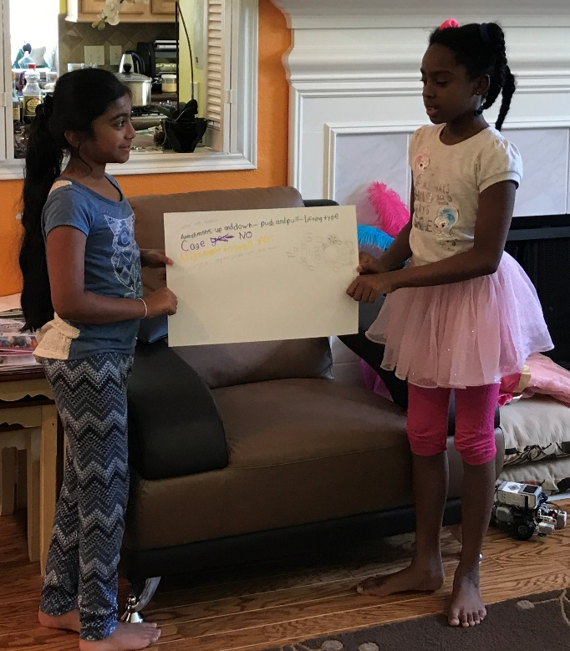
Encouraging communication
Follow the team rules and these (if they are not listed)
Take turns
Once you say an idea, it belongs to the team
Building on each other’s ideas is great!
Don’t say “no”, say “Yes, and…”
See https://youtu.be/x27_qslF8Ko (Second City Improv technique)
Have team members and sub-teams present their ideas to the rest of the group
Sub-teams of 2 presented and discussed before a final design was selected

Slide 9
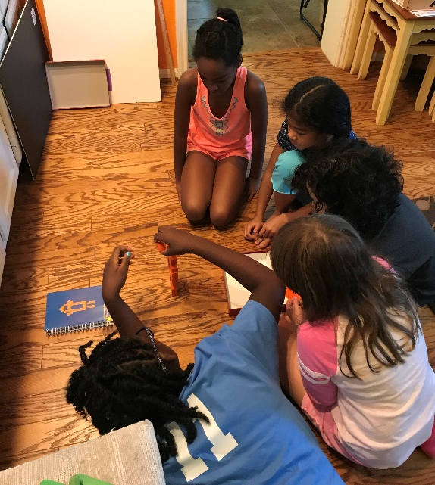
Handling conflicts
Conflict happens, it’s how the team deals with it that counts
Ask the team members involved to work it out
If they can’t then help mediate the discussion
If still not resolved, do 2 out of 3 for rock-paper-scissors
If still “hard feelings”, chat individually
Tower Building

Slide 10
CREDITS
This lesson was written by James McGill (james_mcgill@yahoo.com)
More lessons for FIRST LEGO League are available at www.flltutorials.com
Creative Commons Attribution-NonCommercial-ShareAlike 4.0 International License

