Slide 1
FIRST LEGO League Challenge Overview
Created by FRC 8027 (Not the Droids You are Looking For and Tiger Techs alumni)

Slide 2
“I don’t use kids to build robots. I use robots to build kids”
- Dean Kamen

Slide 3
Table of Contents
Overview of FIRST LEGO League
Robot Game
Innovation Project
Core Values
Global Innovation Award

Slide 4
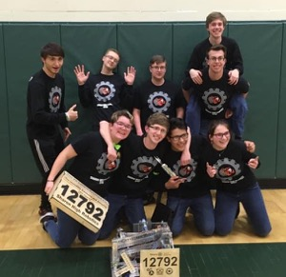
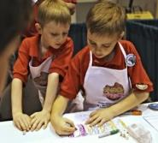
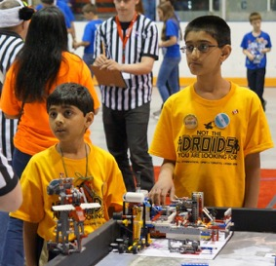
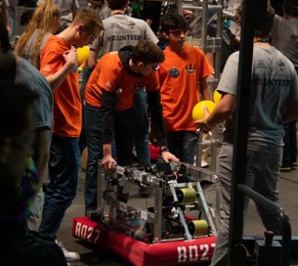
Three FIRST Programs (K-12)
FIRST LEGO League: Discover, Explore, Challenge
FIRST Tech Challenge
FIRST Robotics Competition

Slide 5
What is FIRST LEGO League Challenge?
FIRST LEGO League teams get to:
Research real world problems
Design, build, test and program robots using LEGO Robotics
Apply real-world math and science concepts
Learn critical thinking, team-building, and presentation skills
Participate in tournaments and celebrations
Understand and practice the FIRST Core Values

Slide 6
Team
Children, ages 9 to 14, (grades 4-8) are eligible to participate in North America
Elsewhere 9-16
Teams consists of 2 (minimum) - 10 (maximum) students
Two official adult coaches with clearances per team
Youth and adult mentors are allowed, but kids on the team do the work

Slide 7
Approximate Timeline
August 17, 2021: Challenge documents released
August-November 2021: Team meets weekly to solve the challenge
November-December 2021: Qualifiers
December 2021 -January 2022: State/Regional Championship
April 2022: World Championships
May 2022: Open Invitationals

Slide 8
Team Costs
Robot/Equipment - approx. $500.00 per robot (2 per team is useful)
SPIKE Prime, MINDSTORMS EV3, MINDSTORMS Robot Inventor
Wooden Robotics Table - approx $100.00
National Team Registration- $225
LEGO Challenge Set - $75
Local Tournament Registration - $75-$250 (more in some regions)
Travel Expenses
Shirts/Supplies

Slide 9
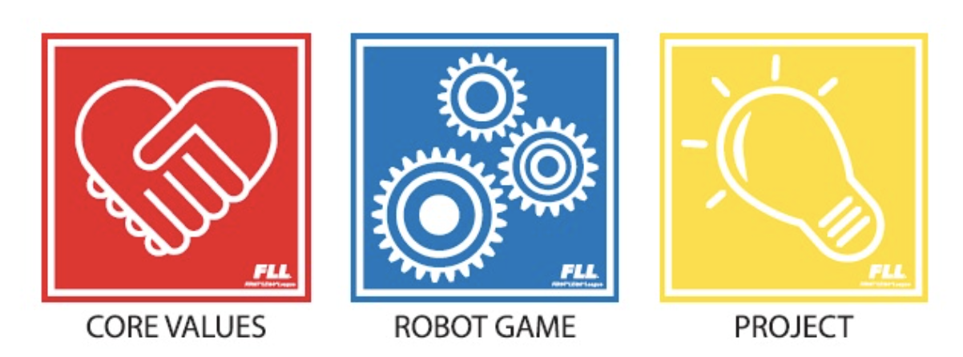
Three Parts of FIRST LEGO League Challenge

Slide 11
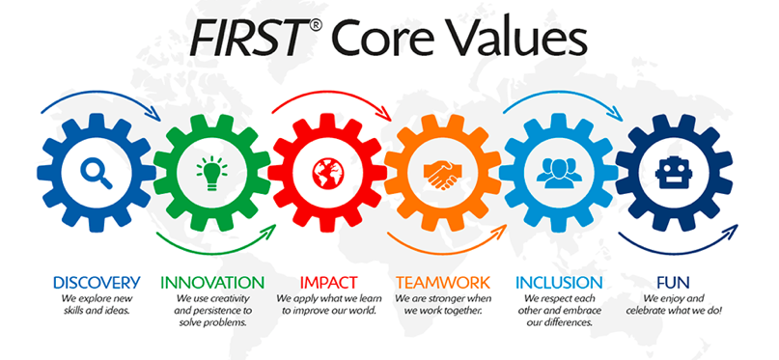
What are Core Values?
The cornerstones of the program.
They are among the fundamental elements that distinguish FIRST from other programs of its kind.
The set of ideas that every FIRST team should live by:
Work with others in a respectful way
Impact the community in a positive way

Slide 12
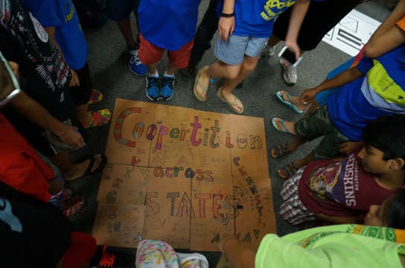
What is Gracious Professionalism and Coopertition?
Gracious Professionalism:
High-quality work, emphasis on the value of others
Respect for individuals and the community.
Competition and mutual gain are not separate notions.
Coopertition:
The idea you should respect and support teams you compete against.

Slide 13
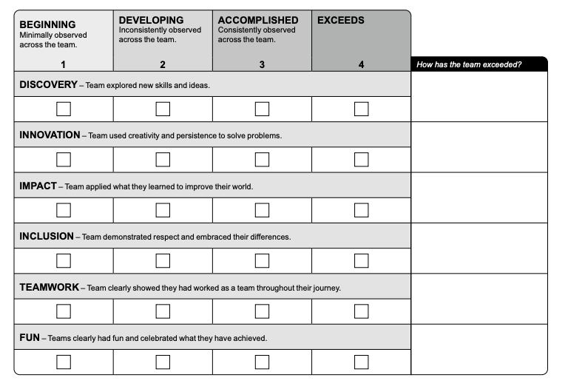
Core Values Rubric
The rubric addresses the major elements that teams are judged on and how overall Core Values skills are evaluated
Students will give examples to demonstrate their understanding and use of each of the Core Values.

Slide 14
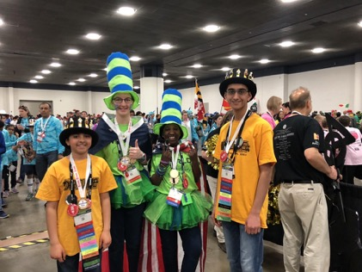
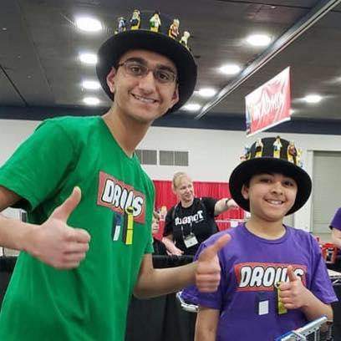
Create a Team Identity/Have Fun
Team Identity is a huge part of being a FIRST team.
Many teams choose to express themselves with hats and team t-shirts.
Helps your team stand out in a crowd
Gives a team a sense of personality and individuality.

Slide 15
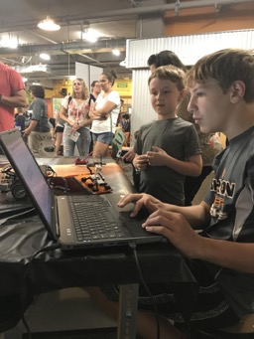
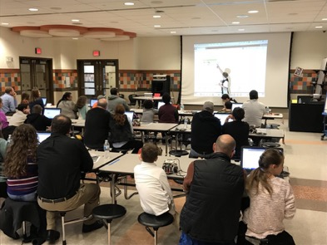
Spread STEM in the Community
FIRST is all about sharing your knowledge of STEM within the community:
Reaching out with other teams,
other students,
or anyone with an interest in STEM
A great way to get others involved and further build your program:
Events
Team Workshops
Online Mentorship

Slide 16
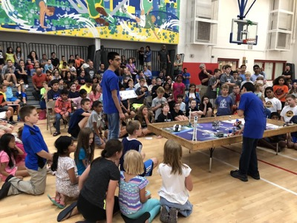
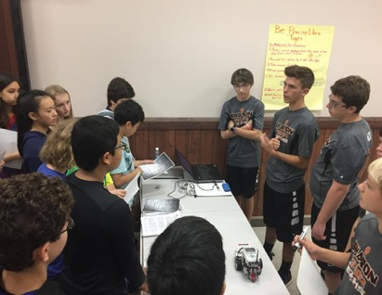
Help Other Teams
Helping out others can do worlds of good within the FIRST community.
Help others, even if you have to compete against one another
Help if you see a team struggle with a mission
Lend parts if you have a missing piece that they do not have
Sharing your knowledge and resources can build bonds with others and spread success on a greater level.

Slide 17
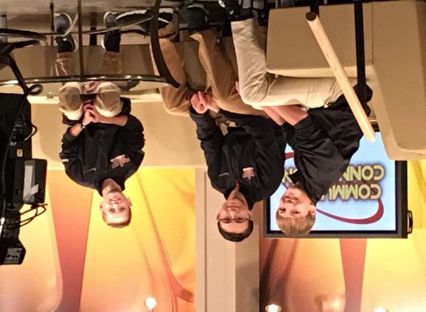
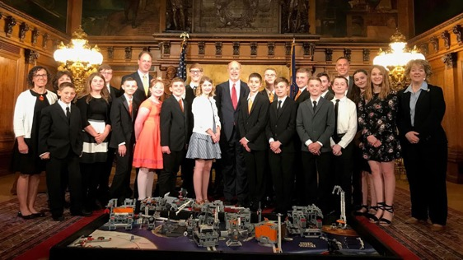
Learn to Communicate
Communication is key when it comes to being a successful team.
Communicate with your own team so you can learn from each other
Communicate with others on and off the field
Teams build communication skills so that they can speak to the media and even the Governor of Pennsylvania
Helps spread the importance of STEM in the community

Slide 18
Core Values Judging
Core Values, just like the other 2 aspects of FIRST has its own set of judging. Judges make evaluations of a team based on the the rubric.
Looking to see if a team understands each of the Core Values and has implemented them on their team
Judges are looking to reward well-rounded team where…
everyone has a role to play
everyone is treated with respect
students have understood FIRST and applied in their daily lives and community
Judging may include a Teamwork Activity (in some regions)
This gives the judges a sense on how everyone works together and how a team can problem solve effectively in tough situations

Slide 19
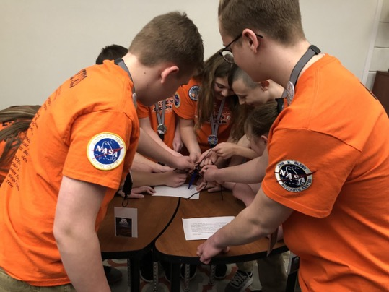
Learn to Work Together as a Team
Help team members get to know each other
Make sure everyone is involved
Help to learn to problem solve in a large group
Help to learn to reach a consensus when there are different ideas
Doing a Teamwork Activity during team practices allows everyone’s voice to be heard and can prepare a team when
it comes time where there is a real challenge at hand.

Slide 20
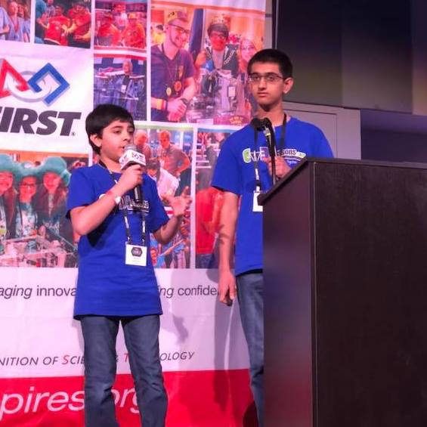
Learning life skills through FIRST
Teamwork
Communication
Problem Solving
Helping one another
Giving back to community

Slide 21
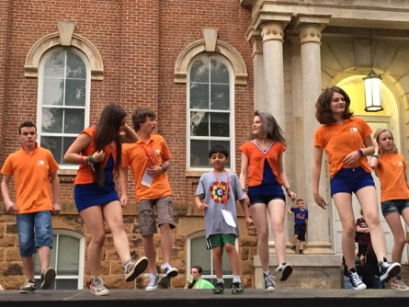
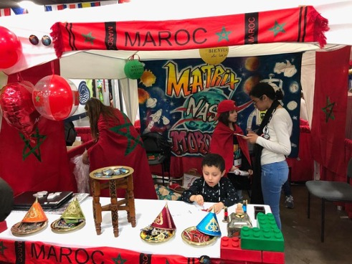
Events
Fun and exciting
Meet teams from different places
People who share similar interests with you
Everyone at events is very willing to help
Learn from each other
Get feedback from judges and improve your work

Slide 23
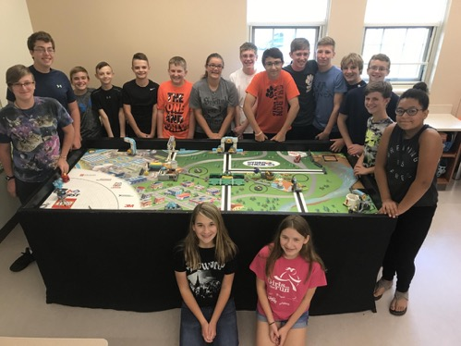
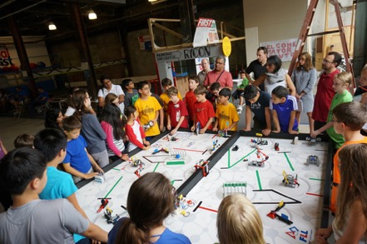
Overview
4ft x 8ft table with a mat
All mission models are LEGO-based
LEGO MINDSTORMS or SPIKE Prime
Yearly theme:
2021 - CARGO Connect
2020 - RePLAY
2019 - City Shaper
2018 - Into Orbit

Slide 24
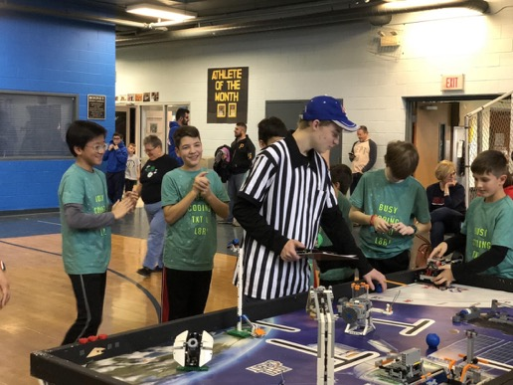
Robot Runs
Robot Competition: 3 rounds, top score qualifies
Each team has 2.5 minutes to complete as many challenges as they can
Each mission on the board is worth a different number of points
Harder missions are not always worth more points
Each mission has its own set of rules and instructions
Referees score you at the end of each run

Slide 25
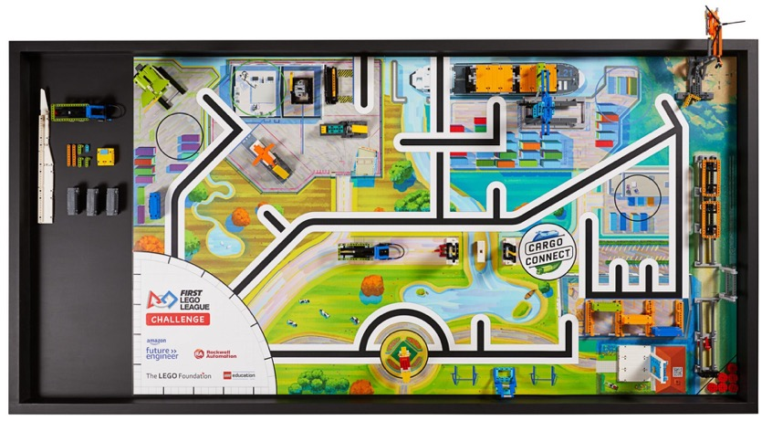
CARGO CONNECT 2021 Season
The theme is based on cargo and transportation
Lines are provided to allow the robot to line follow
Missions are based on real-world scenarios such as moving a turbine blade, unloading/loading containers, etc.

Slide 26
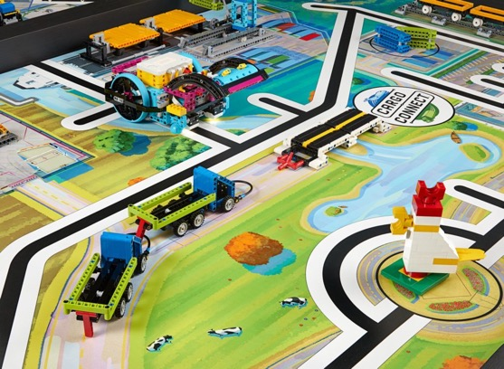
Challenges Teams Face
Building an efficient and sturdy robot
LEGO Technic is often new material for teams
Learning to use the right elements
Learning to build compactly
Teams are often tempted to copy robots from online, but we encourage creativity
Navigating to the correct location requires teams to think about how to use sensors
Sensors are often “scary” for young teams
Teams struggle with reliability
Robot does not behave the same day-to-day or at event

Slide 27
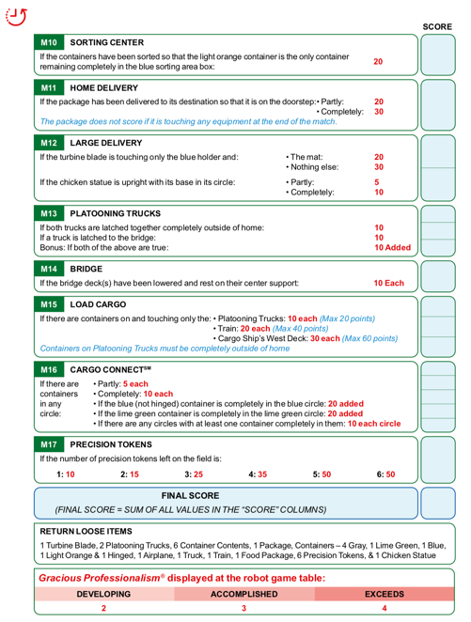
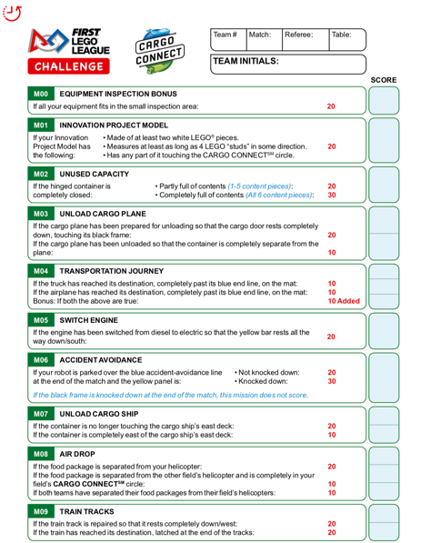
Robot Missions
Typically 15 missions every year
Teams pick and choose based on their experience and ability
FIRST provides the solution to one mission every year to get rookies started
Rookies are expected to complete 2-3 mission reliably
Veteran teams will complete more
A few high-end teams will aim to complete *all* the missions

Slide 28
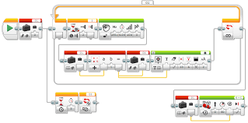
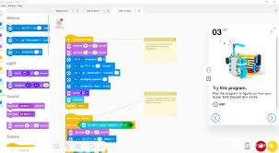
Types of Programming
EV3:
Block-based or Scratch-based
Less condensed approach
SPIKE Prime:
Scratch or Micro Python
Linear approach

Slide 29
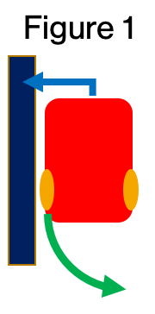
Programming Concepts to Learn Through FIRST
Basic skills
Basic sensor usage, loops, switches, basic line following
Intermediate skills
Custom MyBlocks, decision/logic blocks
Advanced skills
Proportional control, PID line follower, gyro sensor usage, menu system

Slide 30
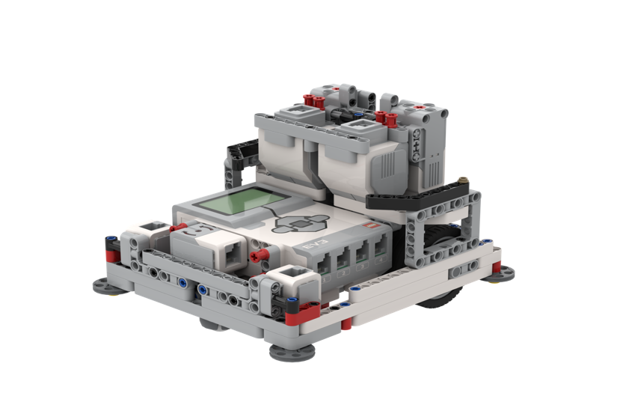
Engineering Concepts you Learn Through FIRST
Students learn physics and engineering concepts when designing a robot
Some teams CAD their LEGO robots
Level construction – notice caster is level with drive wheels
Low center of gravity
Two well-separated, aligned color sensors
Outer walls that support wheels
Wall riding wheels
Color sensors well in front of driving wheels

Slide 31
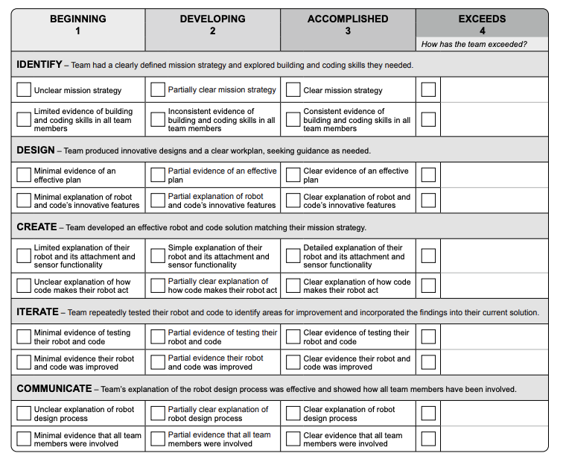
Robot Design Rubric
How the team identifies what they need to do and how they do it
Overall design of their robot
What the team has created
How the team tested their creations
How well the team communicates how they’ve done in each of the other areas.
Focus on all team members programming and building
Team members test and document process

Slide 32
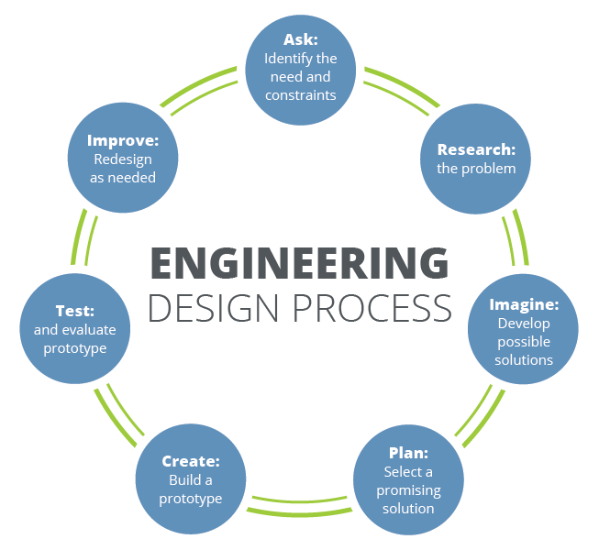
Focus on the Engineering Design Process
Step 1: Analyze the missions and develop a strategy
Step 2: Build and program a robot to meet that strategy
Step 3: Test the robot and make improvements as needed
Step 4: Develop solutions to individual missions
Step 5: Test out code and robot
Step 6: Iterate as needed

Slide 33
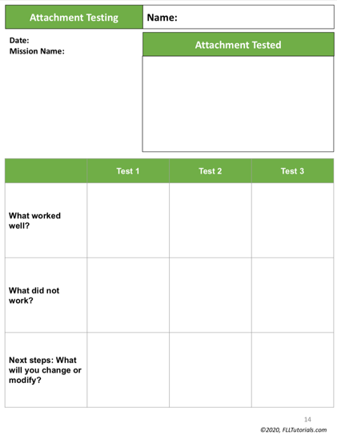
Document Your Engineering Design Process
How the team is following the engineering design process
Document any changes made
Document how much progress was made at every practice
Document any new strategies
Create goals for the next practice to plan what the team needs to work on next

Slide 34
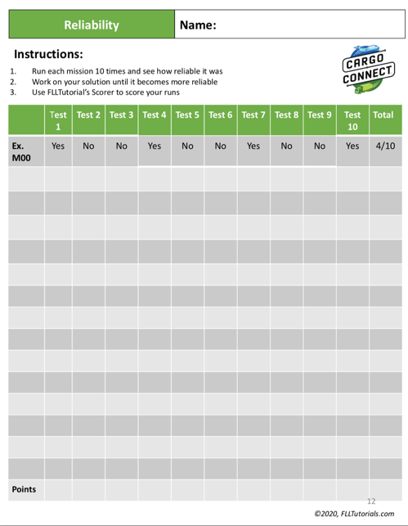
Robot Testing is Very Important
•Test your runs 10 times to see if they work. If they do not, think about how to make them more reliable
•No two competition tables are alike
•Shift the mats, change tables, move the mission models slightly

Slide 35
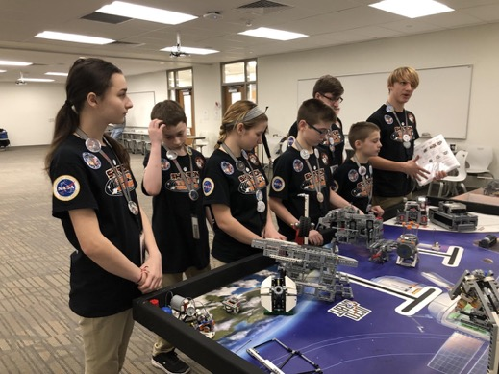
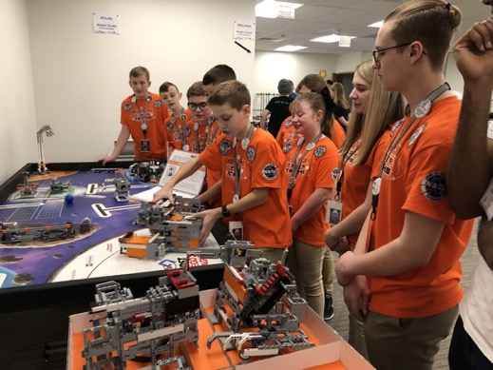
Judging
Create a presentation that showcases the work of the team (usually 4-5 mins)
Explain the engineering process.
Point out the greatest strengths and innovations in both building and programming

Slide 37
Innovation Project is based on a yearly theme
2020-2021 RePlay Season - Help people get more active
2019-2020 City Shaper Season - Improve a building or space in your community
2018-2019 Into Orbit Season - Improve mental or physical health in space
2017-2018 Hydrodynamics Season -Improve the way people find, transport, use, or dispose of water.

Slide 38
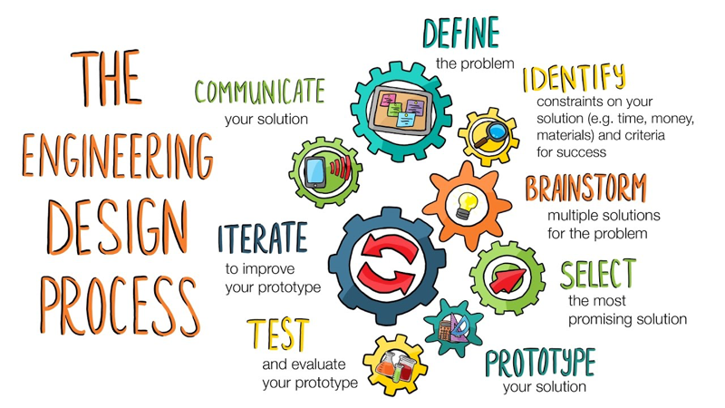
Research Project Process/Engineering Design Process
Identify a problem
Design a solution
Create a prototype
Share with experts
Iterate your design

Slide 39
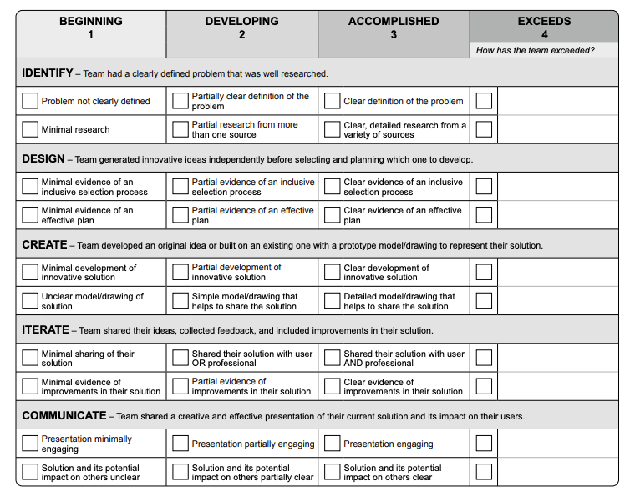
Innovation Project Rubric
Project Rubric includes the engineering design process
Provides team with the process of how they are going to be evaluated
Teams are asked to create a drawing/prototype, share the solution with others, and iterate the design

Slide 40
Identify a Problem
INTO ORBIT Sample:
Identify a physical or social problem in space with long term space flight.
Research Problem:
Due to little to no gravity in space, body fluids rush toward the head and extremities causing many problems for astronauts.
Teams research a topic according to the yearly theme
Team members need to:
brainstorm ideas within the topic
conduct research
take notes when doing research
be sure everyone is participating
be aware of existing solutions
keep an open mind for ideas

Slide 41
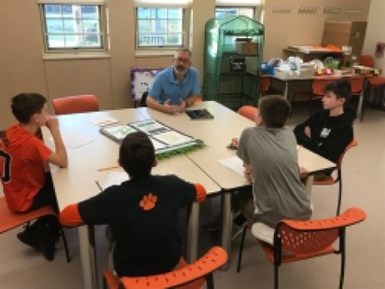
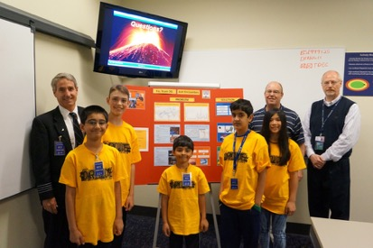
Meet Experts
Brainstorm what experts to contact
Only choose experts who would benefit your team,
e.g. if you have an idea for an app, meet with a developer.
Keep in mind that you can always meet with an expert virtually.
Make sure that all team members can attend so that everyone can ask questions and learn as much as possible.
Take notes to retain as much information as possible
When meeting with an expert it is a good idea to take pictures to show the judges at your event

Slide 42
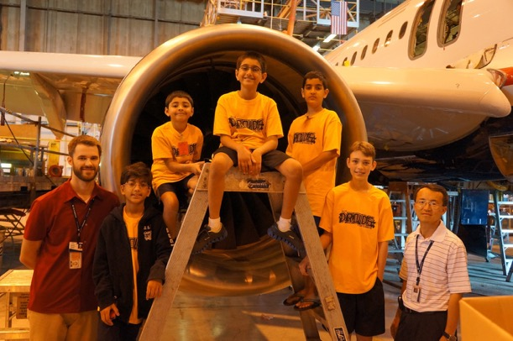
Go on Fieldtrips
Great way to learn about problems
E.g. the Tiger Techs visited New York City to learn about the city's urban planning.
Taking a field trip doesn’t have to be as big a going to New York City
Even a local park or city council
Important to take notes so that you can reflect what you learned.
Be sure to ask questions, take lots of pictures and observe as much as possible when taking field trips.
Field trip to US Airways to learn about engines

Slide 43
Design And Create A Solution
INTO ORBIT Sample Continued:
Design:
As a team, the Techs came up with many spacesuit designs based off of existing solutions.
For example, during a field trip we saw one existing solution at the Air and Space Museum in Washington, D.C.
Create a Solution:
Using information learned during the research phase, we designed a prototype. The name of our suit was Shape Shifter.
Teams take research and apply it to a new innovative design
Design should improve something or be brand new
A good way to start is with multiple drawings to get the team’s idea on paper
Continue to meet with experts for feedback
Prototypes are required this year for project
For advanced teams, CAD could be an option for a prototype
Documentation should be kept throughout the entire process for a journal

Slide 44
Iterate
INTO ORBIT Sample Continued:
Iteration Process:
The team sampled several materials for the layers of the space suit.
Fasteners such as buttons, zippers and velcro were tested to determine how strong they would be.
We reached out to a space suit design company to provide feedback for our suit.
Teams test designs and then continually improve them
Any feedback given by experts should be used to improve design
Documentation is important during this step
Record results from testing
Continue testing until team is satisfied with the results

Slide 45
Share With Experts
INTO ORBIT Sample Continued:
Sharing with Experts:
The Techs shared their product with:
a cardiologist
professional athlete
astronaut Mike Fincke
biomedical engineer
several experts at NASA
Team’s reach out to an individual, business, or an organization that would benefit from the solution and pitch idea to them
Return to your original experts so that they can see the entire engineering design process
Take feedback as a way to improve the design
Sharing can be virtual or in person

Slide 47
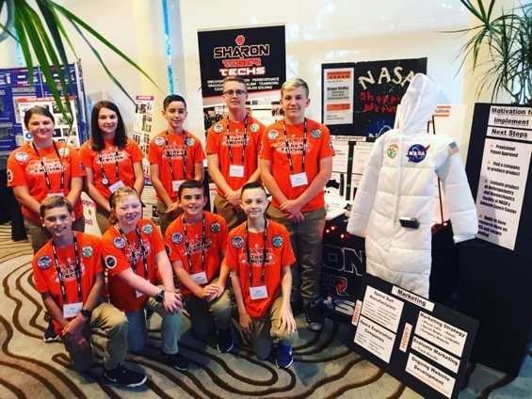
What is GIobal Innovation Award?
Started in 2011
Showcases teams’ innovative projects
GIA requires teams to go more in depth with their project than before
Many GIA teams get patents, meet leaders, etc.
There is no additional cost to participate in GIA other than travel costs if you make top 20

Slide 48
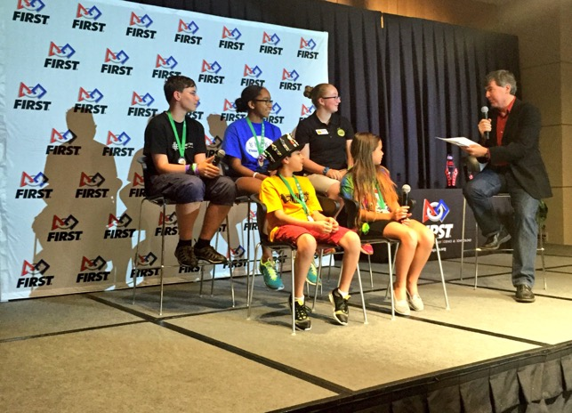
How do you qualify for it?
Most regions nominate the top-ranked Innovative Solution team(s) from their Championship.
Some have a separate judging process
Nominated teams submit an application to qualify for the top 20
Application has many essay questions about the project and solution
The top 20 submit an Engineering Change document before they attend the final event if they have made any changes since submission

Slide 49
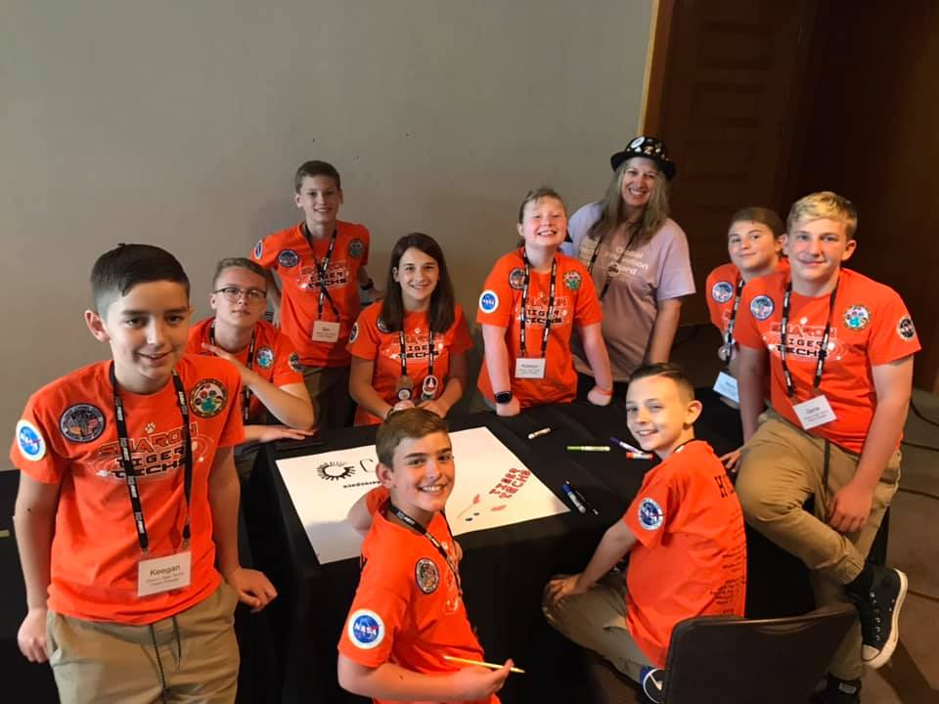
What happens when you make Top 20?
20 teams semi-finalist compete at the annual event
Prior to the event, teams create pitches
At the event, teams present their idea to a panel of judges
$20,000 to help further develop product
Teams interact with each other
Teams meet experts in field
Learn about patents and innovation

Slide 50
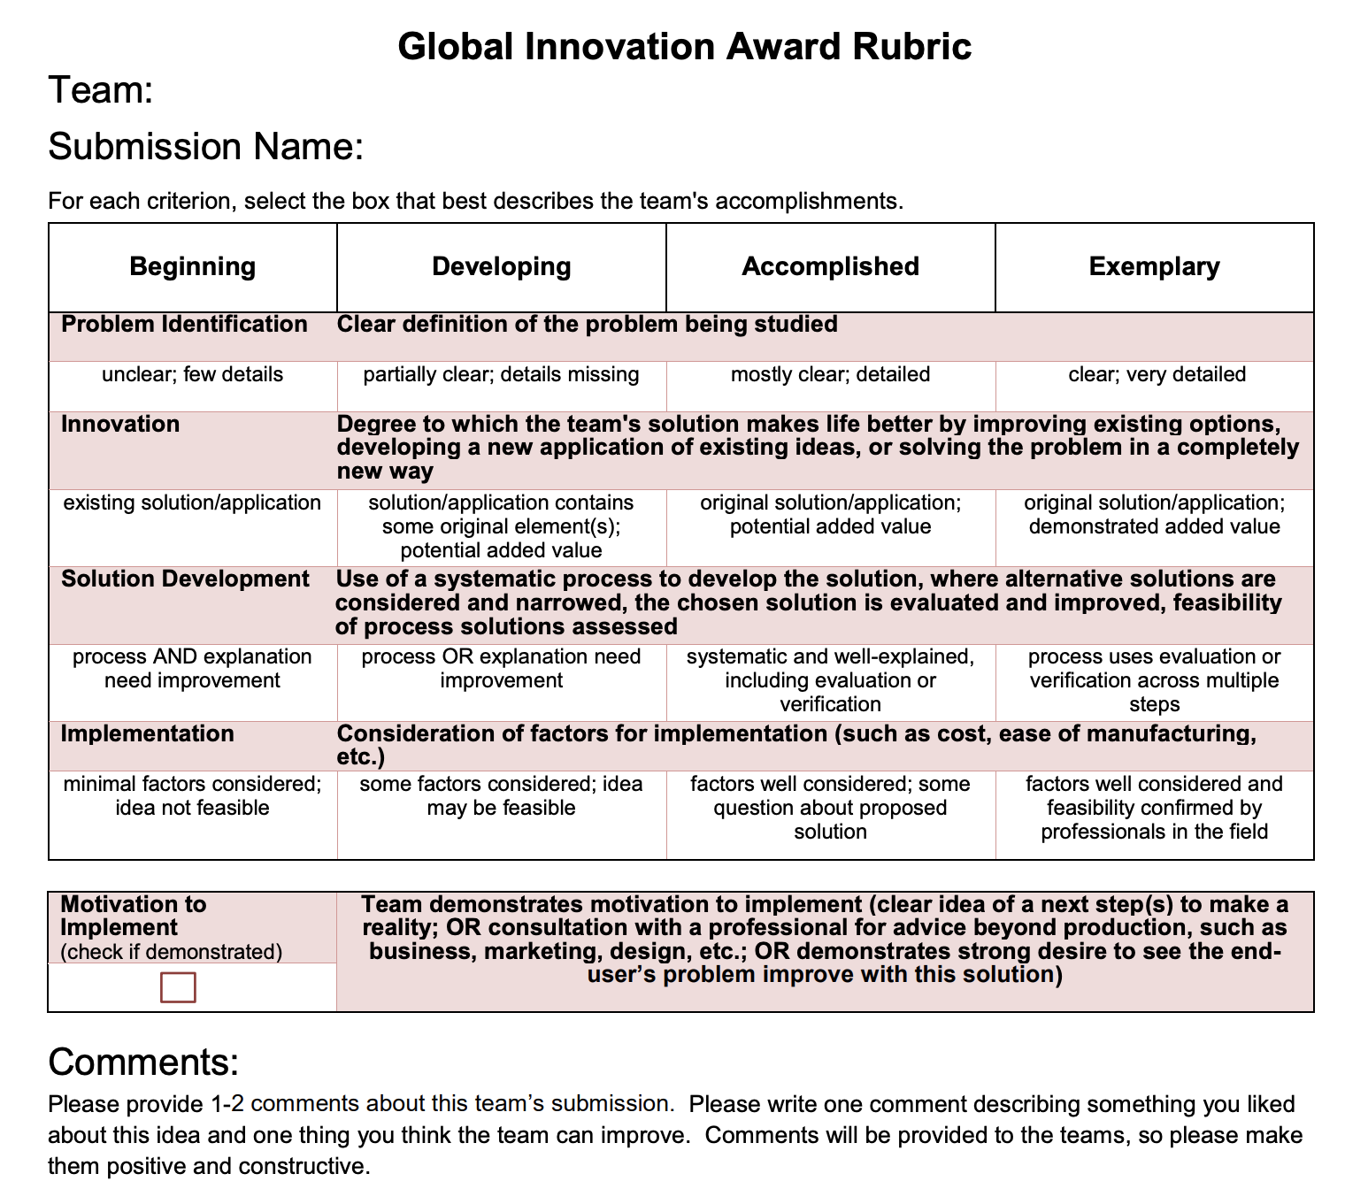
GIA has a seperate rubric
Different from normal project rubric
Rubric will help team think more in depth than before
Teams who base strategy around rubric will excel

Slide 51
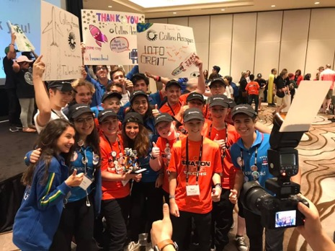
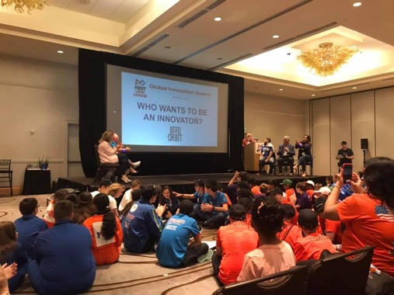
Why is GIA important?
The GIA leaves a huge impact on teams
Friendships are made over the few days
Teams will meet experts and inspirational people
Many teams will further develop their product and get patents
These experiences will prepare teams for future FIRST programs

Slide 52
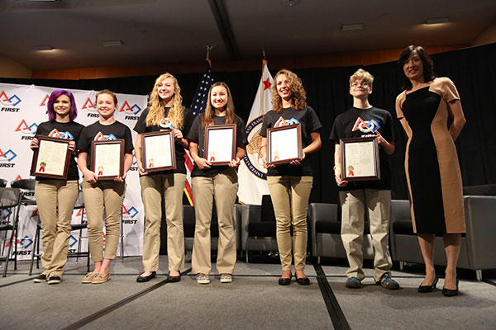
2010 Body Forward
BOB-1 Hand Device by The Flying Monkeys of Ames, Iowa
Low-cost prosthetic device
Represented FIRST at the White House Science Fair
June 16, 2015: U.S. Patent No. 8,840,157

Slide 53
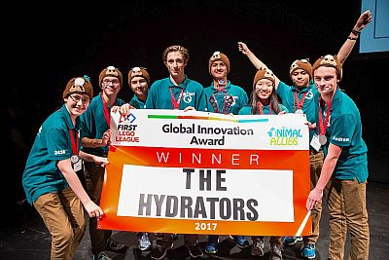
2016 Animal Allies
The H20 Post by The Hydrators of Oakville, Ontario, Canada
The H20 Post (Horses Hydrating Outside) monitors the amount of water horses drink.

Slide 54
2020 City Shaper
E-Wall by Aldeatron Robotix of the Canary Islands, Spain
Low cost, lightweight, eco-friendly building block made from recycled cardboard and Fountain grass.

Slide 55
This presentation and most of the team images are by Not the Droids You Are Looking For and Tiger Techs. Other images are obtained from FIRST LEGO League.
QUESTIONS?

